Slide 1

To discount or not!
Asli, Sunni, Hristo, Osveh
April 18, 2023

Slide 2
Is it beneficial to offer discount on products?
Discounts?
Marketing Team
Investors
Beneficial in long term
Increase customer acquisition and satisfaction
Decrease total revenue
Concentrate on quality segment
Notes:
Marketing Team Lead: 1. Offering discounts is beneficial in the long run.
2. Discounts improve customer acquisition, satisfaction and retention, and allow the company to grow
Investors in the Board: 1. Decrease in total revenue due to aggressive discounts
2. Company should position itself in the quality segment, rather than competing to offer the lowest prices in the market

Slide 3
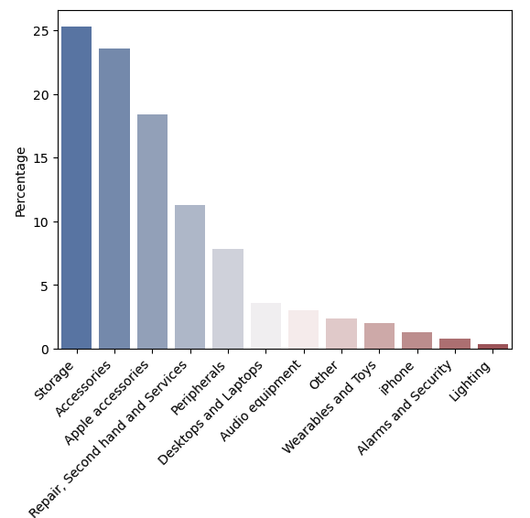

Product Classification
Total number of products: 7464

Slide 4
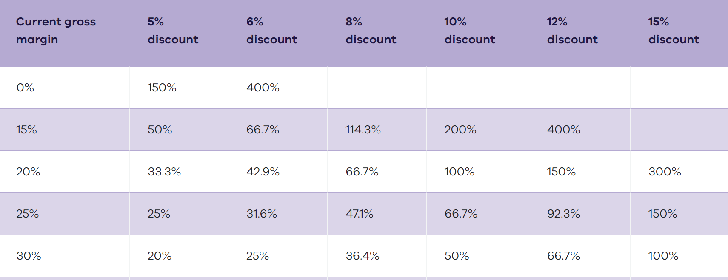
How discounting affects your sales targets
For example, if your gross margin is 30% and you decide to discount your goods or services by 10%, you'll need to increase your sales volume by 50% to make a profit.

Slide 5
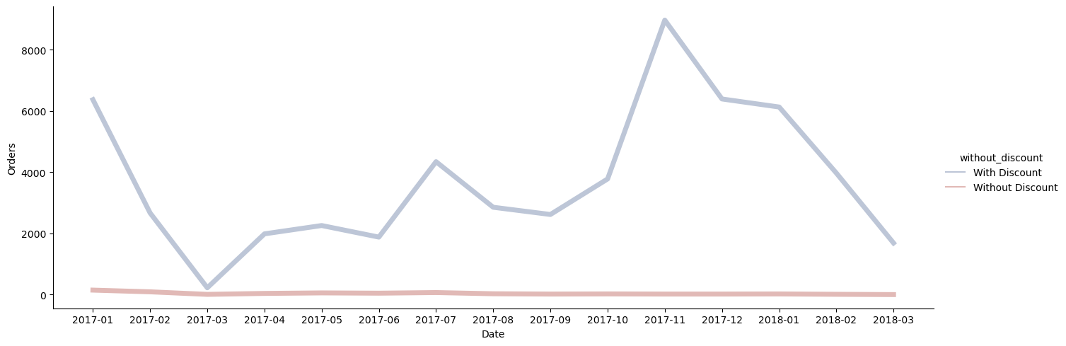
Orders with discounted products

Slide 6
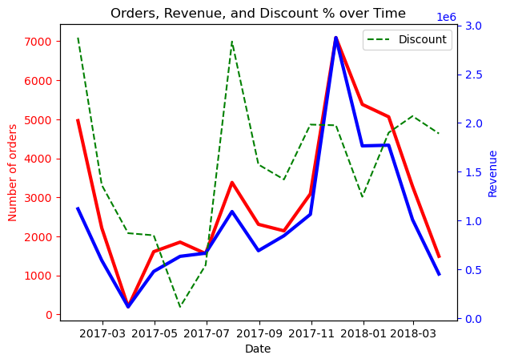
Orders, revenue, and discount in total

Slide 7
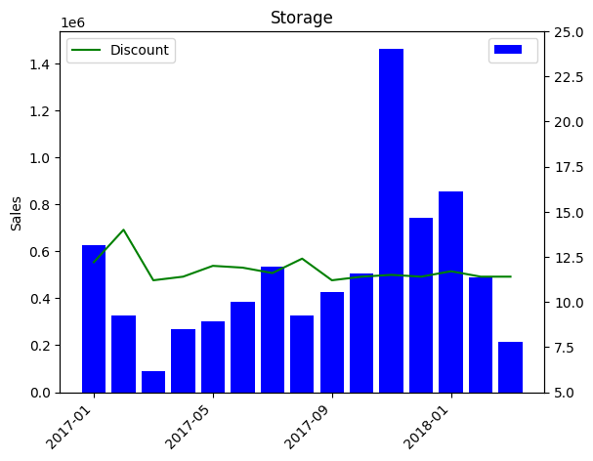
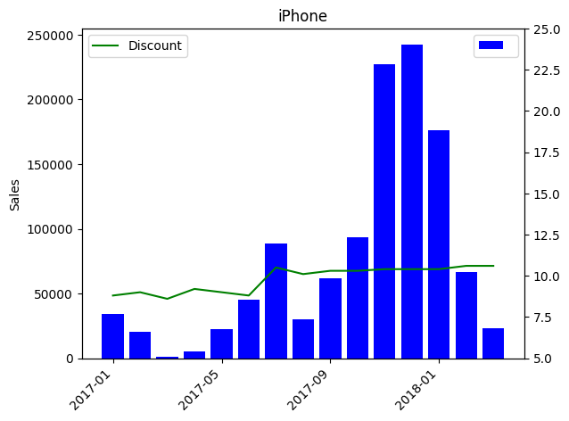
Revenue and discount per category

Slide 8
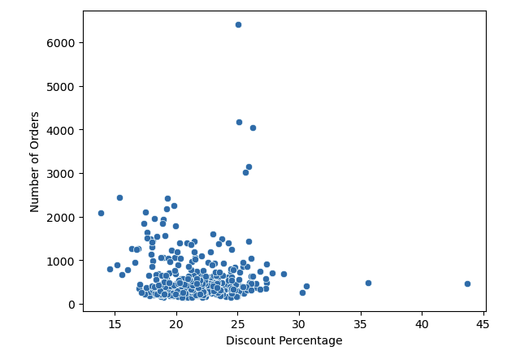
Discount ~ Sales
p-value >> 0,05
for yearly, monthly, and daily aggregation
No statistically significant results!

Slide 9
Conclusion
Option A - Do not change discount strategy – try other marketing tools
Build a customer loyalty program
Stick to seasonal patterns—for ex. two sales per year
Option B - Apply discounts to specific categories, and follow conventional guidelines
Data collection Improvements
Provide customer information (quantify the trade-off between the short-term and long-term gains)
Provide categorization
Provide cost information (purchasing, shipping, storage)

Slide 10
Thank you !

Slide 11
Guiding Question
Is it beneficial to offer discount on products?

Slide 12
Conclusion
Regular discount strategy:
Customers start to expect it and will wait to purchase when the sale rolls around
Regular discounting can lower the perceived value and quality of your brand
You can attract conditional shoppers instead of loyal customers

Slide 13
Hypothesis Testing
How do discounts affect sales?
Hypothesis to be tested: (#of order) & (# of %discounted products) positively correlated

Slide 14
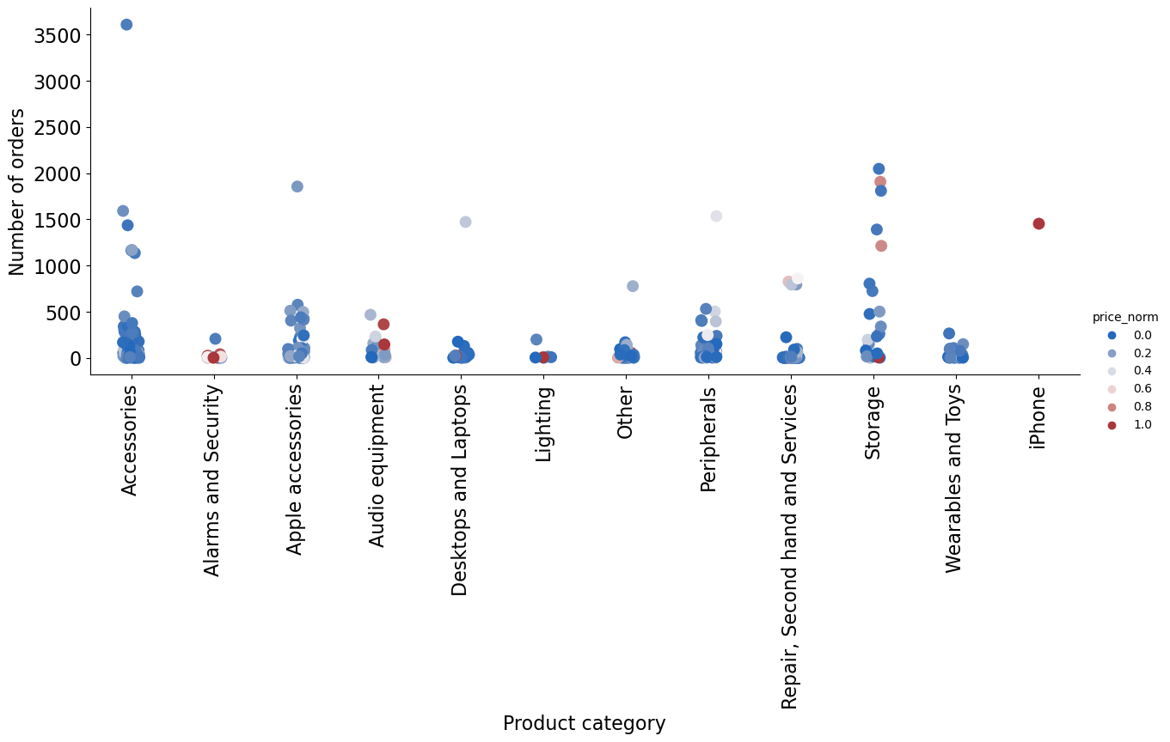
Importance of product quality on sales

